Slide 1


Using Metric Space Indexing for Complete and Efficient Record Linkage
Özgür Akgün¹, Alan Dearle¹, Graham Kirby¹, Peter Christen²
¹ School of Computer Science, University of St Andrews
² Research School of Computer Science, The Australian National University

Slide 2
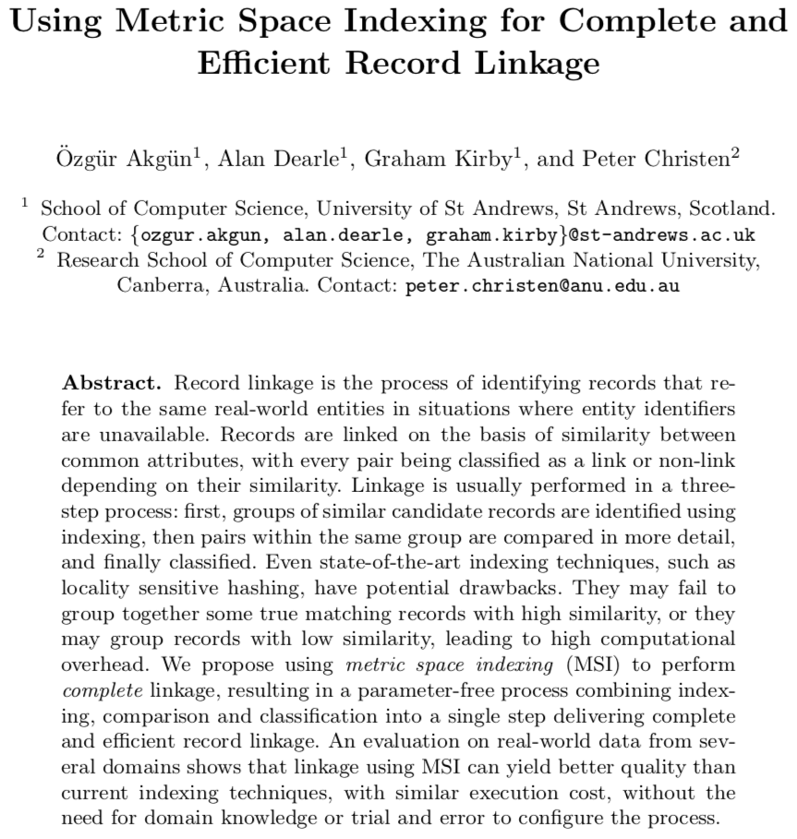
Presenting at PAKDD 2018 next week
Available: https://github.com/digitisingscotland/pakdd2018-metric-linkage

Slide 3
Abstract
Record linkage is the process of identifying records that refer to the same real-world entities in situations where entity identifiers are unavailable.
Records are linked on the basis of similarity between common attributes, with every pair being classified as a link or non-link depending on their similarity.
Linkage is usually performed in a three-step process: first, groups of similar candidate records are identified using indexing, then pairs within the same group are compared in more detail, and finally classified.
Even state-of-the-art indexing techniques, such as locality sensitive hashing, have potential drawbacks.
They may fail to group together some true matching records with high similarity, or they may group records with low similarity, leading to high computational overhead.
We propose using metric space indexing (MSI) to perform complete linkage, resulting in a parameter-free process combining indexing, comparison and classification into a single step delivering complete and efficient record linkage.
An evaluation on real-world data from several domains shows that linkage using MSI can yield better quality than current indexing techniques, with similar execution cost, without the need for domain knowledge or trial and error to configure the process.

Slide 4
Record Linkage – What?
Record linkage is the process of identifying records that refer to the same real-world entities in situations where entity identifiers are unavailable.
Records are linked on the basis of similarity between common attributes, with every pair being classified as a link or non-link depending on their similarity.

Slide 5
Record Linkage – How?
Linkage is usually performed in a three-step process: first, groups of similar candidate records are identified using indexing, then pairs within the same group are compared in more detail, and finally classified.

Slide 6
Record Linkage – How?
Linkage is usually performed in a three-step process: first, groups of similar candidate records are identified using indexing, then pairs within the same group are compared in more detail, and finally classified.
Even state-of-the-art indexing techniques, such as locality sensitive hashing, have potential drawbacks.
They may fail to group together some true matching records with high similarity, or they may group records with low similarity, leading to high computational overhead.

Slide 7
Record Linkage – Proposal
Metric space indexing (MSI) to perform complete linkage
A parameter-free process
Combining indexing, comparison and classification

Slide 8
Context – Digitising Scotland & ADRC
Digitising Scotland (ES/K00574X/1)
https://digitisingscotland.cs.st-andrews.ac.uk
Digitise the 24 million Scottish vital events records (births, deaths, and marriages) since 1855
ADRN – Administrative Data Research Network
ADRC-England, ADRC-N Ireland, ADRC-Wales
ADRC-Scotland (ES/L007487/1)
Linkage of these records

Slide 9
Scotland’s Records
Birth record
Contains 3 people: baby, father, mother
Birth date
Parent’s marriage date and place
Death record
Contains 4 people: deceased, their spouse, father, mother
Age at death
Marriage record
Contains 6 people: groom, bride, their parents
Date and place

Slide 10
Scotland’s Records - Births
1. Unique 'Record' Identifier
2. Child’s surname
3. Child’s Forename
4. Sex
5. Year of Registration
6. Registration District Number
7. Registration District Suffix
8. Entry
9. Birth Day
10. Birth Month
11. Birth Year
12. Mother’s Maiden Surname
13. Birth Address
14. Father’s Forename
15. Father’s Surname
16. Father’s Occupation
17. Mother’s Forename
18. Mother’s Surname
19. Parent’s Day of Marriage
20. Parent’s Month of Marriage
21. Parent’s Year of Marriage
22. Parents Place of Marriage
23. Illegitimate indicator
24. Informant
25. Informant did not Sign
26. Adoption

Slide 11
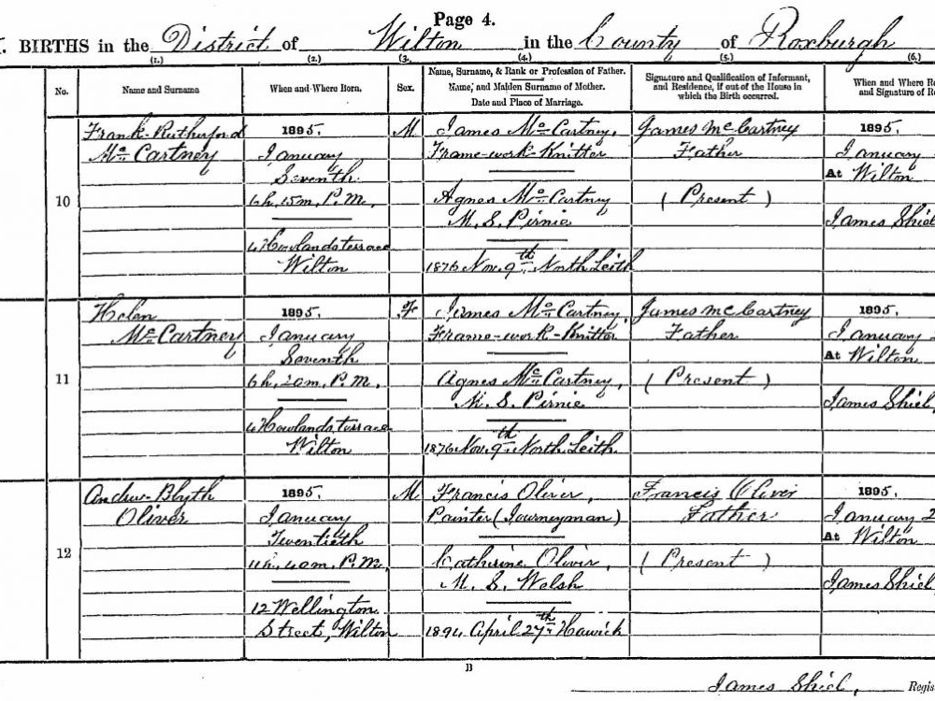

Slide 12
Scotland’s Records - Deaths
1. Unique 'Record' Identifier
2. Surname
3. Forename
4. Sex
5. Year of Registration
6. Registration District Number
7. Registration District Suffix
8. Entry
9. Death Month
10. Death Day
11. Death Year
12. Age at Death
13. Date of Birth
14. Occupation
15. Marital Status
16. Spouse’s Name(s)
17. Spouse’s Occupation(s)
18. Place of Death
19. Father’s Forename
20. Father’s Surname
21. Father’s Occupation
22. Father Deceased
23. Mother’s Forename
24. Mother’s Maiden Surname
25. Mother Deceased
26. Cause of Death
27. Certifying Doctor

Slide 13
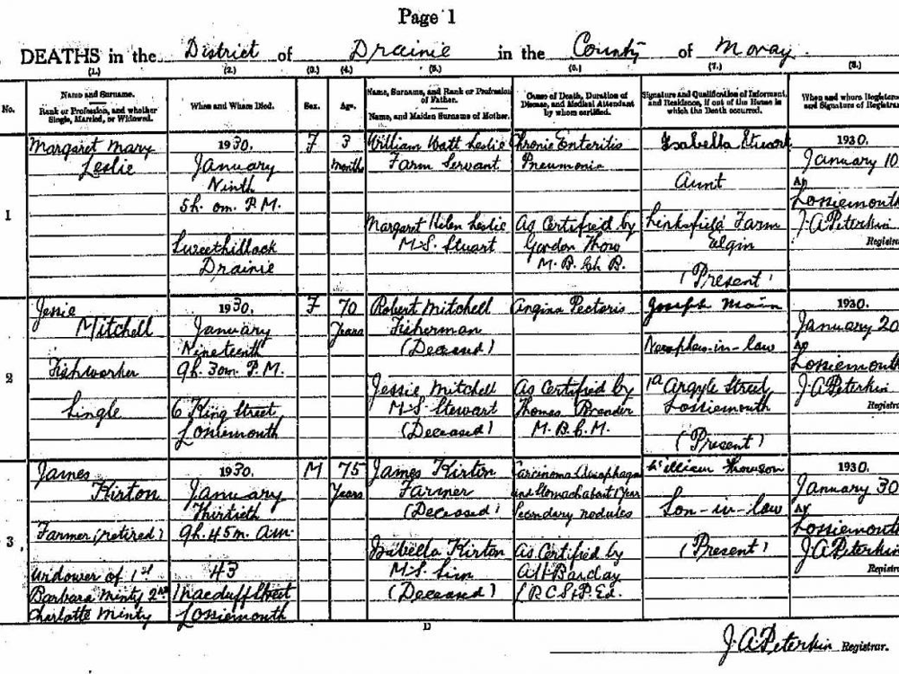

Slide 14
Scotland’s Records - Marriages
1. Unique 'Record' Identifier
2. Groom’s Surname
3. Groom’s Forename
4. Bride Surname
5. Bride Forename
6. Marriage Day
7. Marriage Month
8. Marriage Year
9. Place of Marriage
10. Year of Registration
11. Registration District Number
12. Registration District Suffix
13. Entry
14. Denomination
15. Groom’s address
16. Groom age or date of birth
17. Groom’s occupation
18. Groom’s marital status
19. Bride’s address
20. Bride’s age or date of birth
21. Bride’s occupation
22. Bride’s marital status
23. Groom Father’s Forename
24. Groom Father’s Surname
25. Groom Father Deceased
26. Groom Mother’s Forename
27. Groom Mother’s Maiden Surname
28. Groom mother Deceased
29. Groom Father Occupation
30. Bride Father’s Forename
31. Bride Father’s Surname
32. Bride Father Deceased
33. Bride Mother’s Forename
34. Bride Mother’s Maiden Surname
35. Bride Mother Deceased
36. Bride Father Occupation
37. Groom did not Sign
38. Bride did not Sign

Slide 15
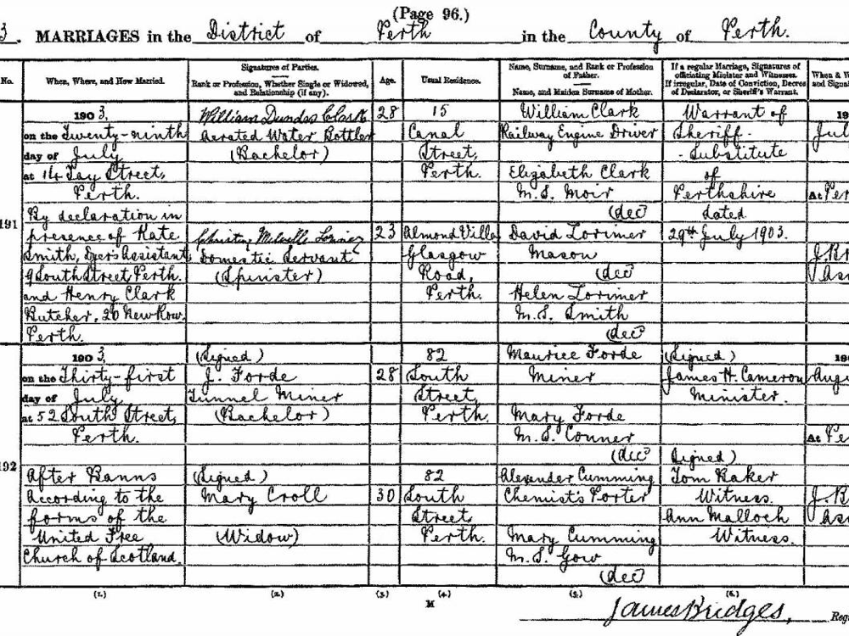

Slide 16
Record Linkage – Distance calculation
Data set A and B
Same kind of entities in A and B
A number of fields (containing strings, numbers, dates)
Distance method per field
Combined distance value between entities
Two entities “close enough” → links
We cannot afford calculating all pairs of distances
If we could, this paper would have been unnecessary

Slide 17
Record Linkage – Indexing/Blocking
For each record in A, a cheap way of identifying candidates from B
Calculate distances on this subset only
May lose some
Requires design (trial and error)
In addition to the design required for the distance method

Slide 18
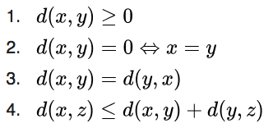
Record Linkage – Metric Space Indexing
Using a data structure called Metric Tree (M-Tree)
No additional design needed
Provided the distance method is metric

Slide 19
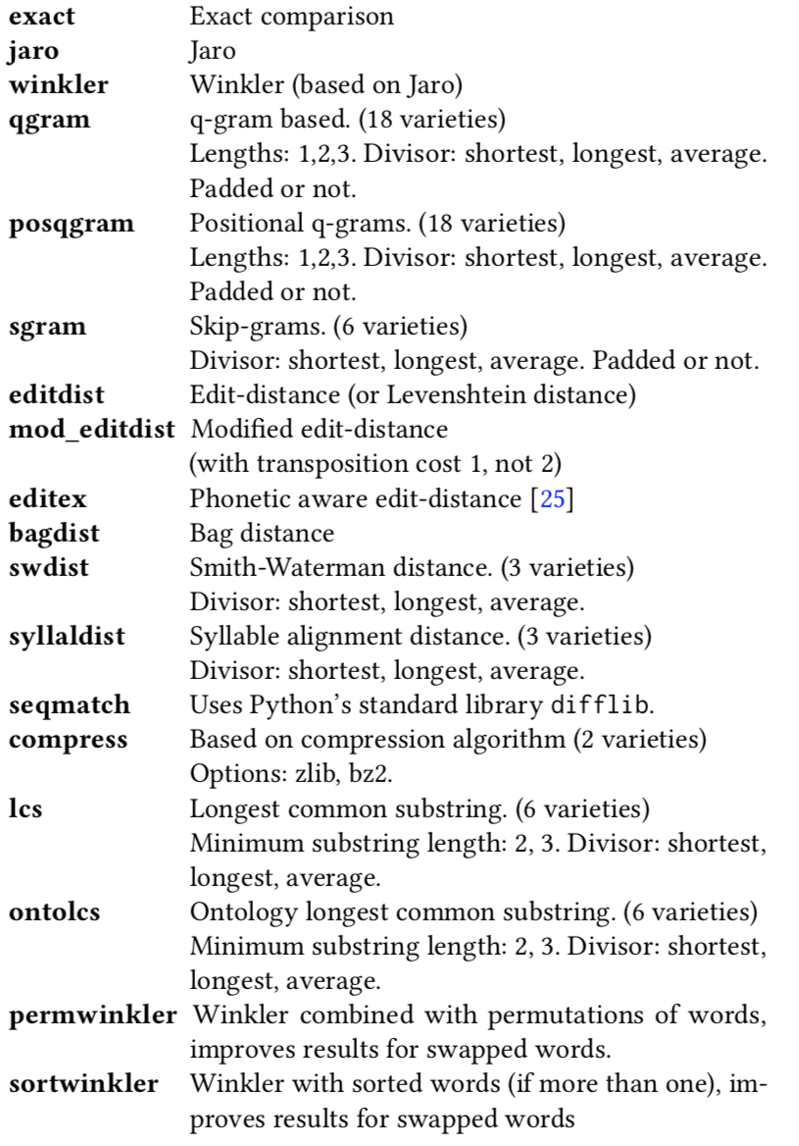
Record Linkage – Metric Distances
Febrl has 72 different string similarity methods

Slide 20
Record Linkage – Metric Distances
Febrl has 72 different string similarity methods
Most are not metric
We use edit distance (Levenshtein) which is metric
Probably not the best distance to use for linkage quality!

Slide 21

Blocking vs Metric Space

Slide 22
Metric Tree
Indexing structure for efficient K-nearest neighbour search
Points organised hierarchically
Binary tree: nodes = sets of points, root = all points
Siblings are disjoint
Two main methods provided
Find all points within a given radius
Find a number of closest points

Slide 23
Metric Tree - Constructing
Top-down
Choose two pivot points p(l) and p(r) such that the distance is largest
This is quadratic again, we use a heuristic
Pick a random point, find the farthest point from it, call it p(l).
Find the farthest point from p(l), call it p(r)
Partition
Project all points onto a line from p(l) to p(r)
Find the median point A along the line u
All points on the left of A go to the left subtree, on the right of A to the right subtree
Median ensures tree depth of O(log n) – but it is expensive
Heuristic: we use mean A=(p(l)+pr(r))/2
Imagine a high-dimensional plane orthogonal to u that goes through A
This is the decision boundary – used for querying

Slide 24
Metric Tree - Querying
Top-down
Given a query point and a radius
Consider a sphere around it
Calculate the distance to p(l) and p(r)
Decide left/right/both depending on the distances
Low variation in inter-record distances will reduce efficiency
Also called: high intrinsic dimensionality
Due to insufficient pruning

Slide 25


Euclidean distance, source: https://en.wikipedia.org/wiki/Voronoi_diagram

Slide 26
Manhattan distance, source: https://en.wikipedia.org/wiki/Voronoi_diagram

Slide 27
Linkage using M-Tree
General linkage problem
for two datasets A and B
find all record pairs that have a distance of d or less
Place all records in A into an M-Tree
For all records in B:
List all records within d (a native operation supported by M-Tree)

Slide 28
Approach
General linkage problem
for two datasets A and B
find all record pairs that have a distance of d or less
We compare several linkage algorithms
Incomplete, requires configuration
Traditional indexing on chosen fields
LSH-MinHash
Complete
M-Tree
Brute-force

Slide 29
Approach – Traditional indexing
Pick a subset of fields
Optionally apply a transformation (like Soundex) to values
Place records that have the same value in a block
Only calculate similarity for records that are in the same block

Slide 30
Approach – LSH-MinHash
Parameterised by nbBands, and bandSize
Pick a subset of fields (typically all fields)
Generate bigrams, apply H_{n} to all bigrams, pick the minimum hash value
We have: a vector of hash values
Records are in the same block if
They share the same hash values for any band
More bands = larger blocks,
Wider bands = smaller blocks

Slide 31
Datasets
CORA
Small, allows comparison with Brute Force
1,295 records that refer to 112 machine learning publications
Ground truth available
Linkage over the same dataset (de-duplication)
Demographic (Vital event records)
Isle of Skye: a rural district
Kilmarnock: an industrial town
Of the order of tens of thousands records
Ground truth was generated by the demographers

Slide 32


Slide 33


Slide 34
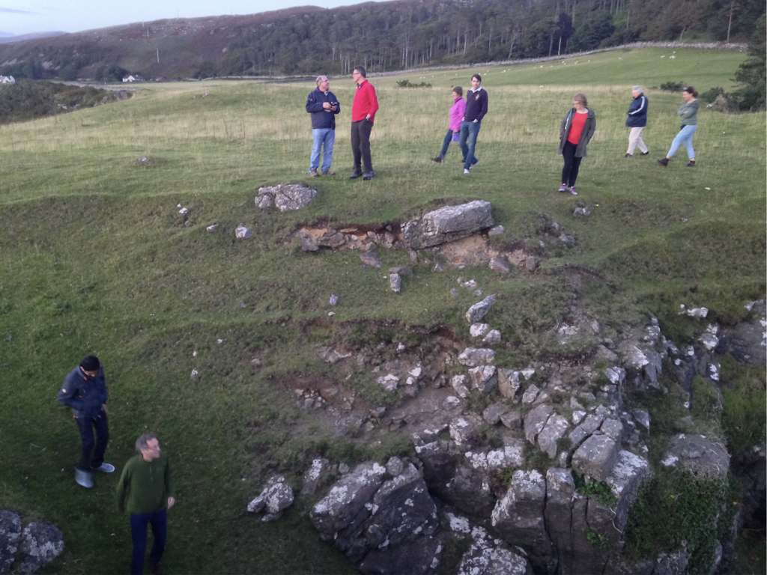

Slide 35
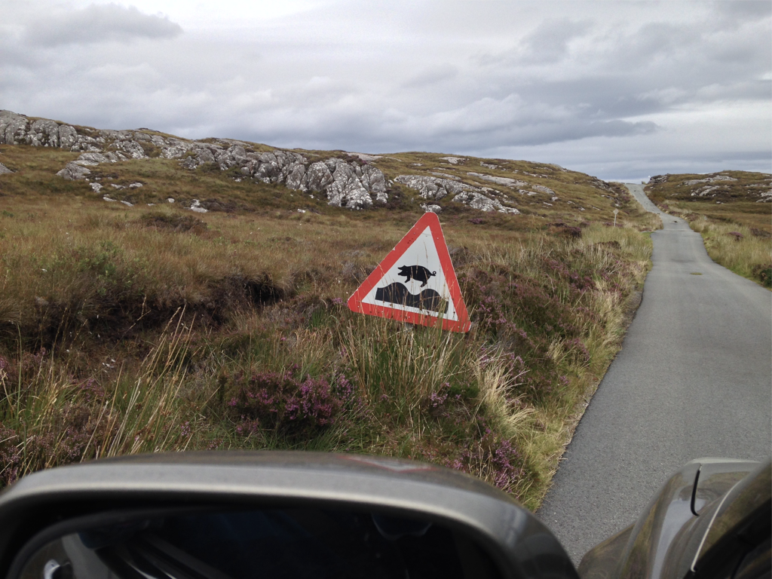

Slide 36
CORA
Traditional blocking
We try: author, title, venue, location, publisher, year, all-combined
Distance threshold varied from 0 to 250
We go up to such high thresholds because this dataset contains low-similarity true matches
LSH is parameterised by number of bands and band size
We try: 2,5,10
M-Tree is not parameterised – hooray!
We compare against Brute Force as well

Slide 37

Linkage Quality
Precision = TP / (TP + FP)
When we claim a link, how often are we right?
Perfect precision: find 1 correct link
Recall = TP / (TP + FN)
How complete are we?
Perfect recall: claim everything is a link!
F Measure = 2 * Precision * Recall / (Precision + Recall)
From: https://en.wikipedia.org/wiki/Precision_and_recall

Slide 38
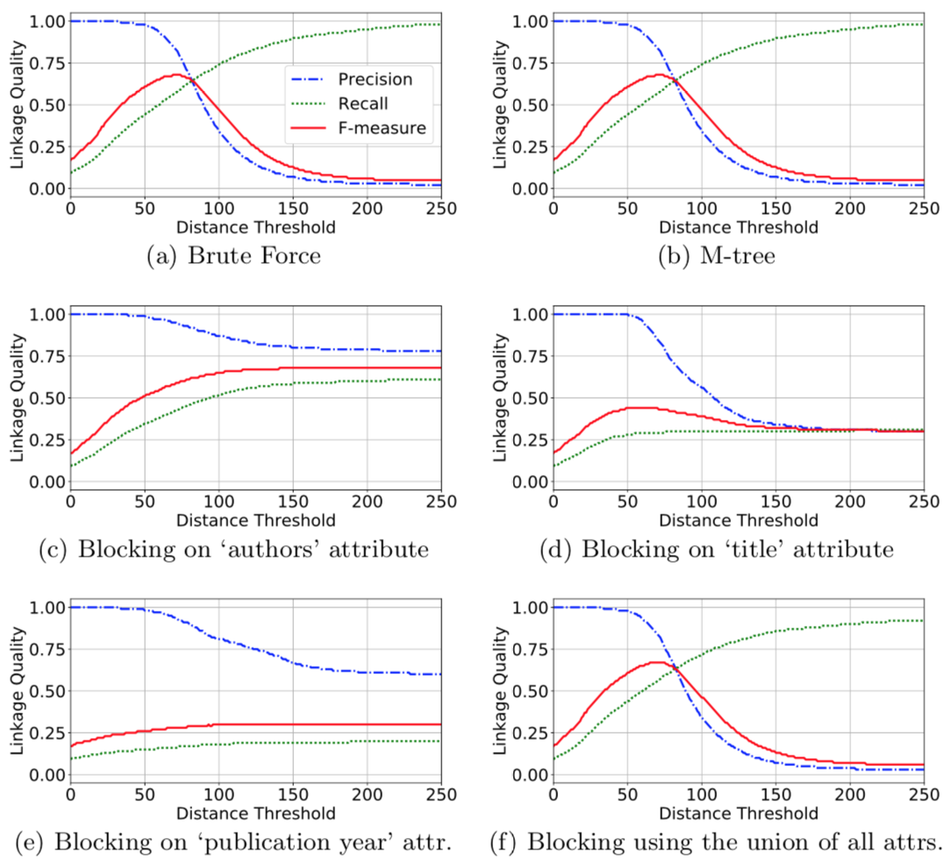

Slide 39
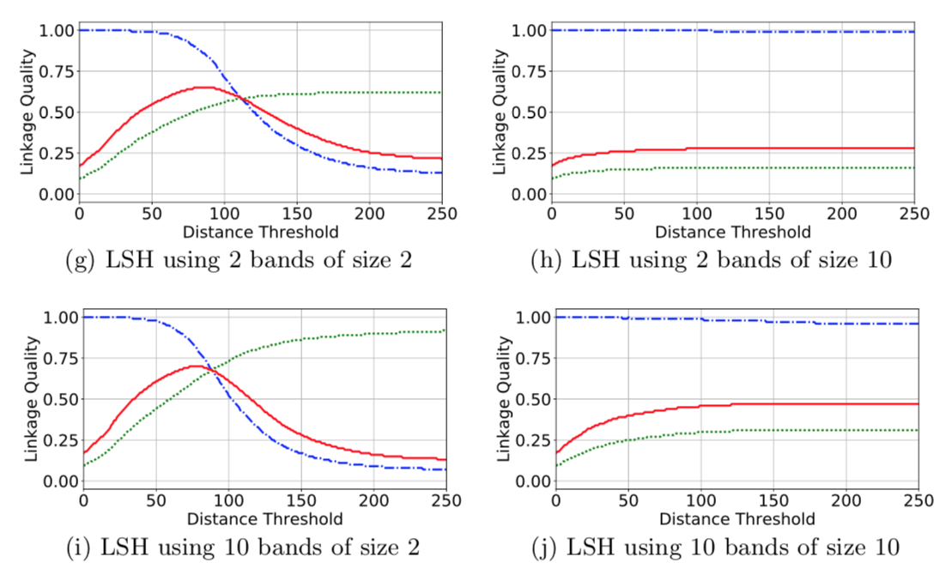

Slide 40
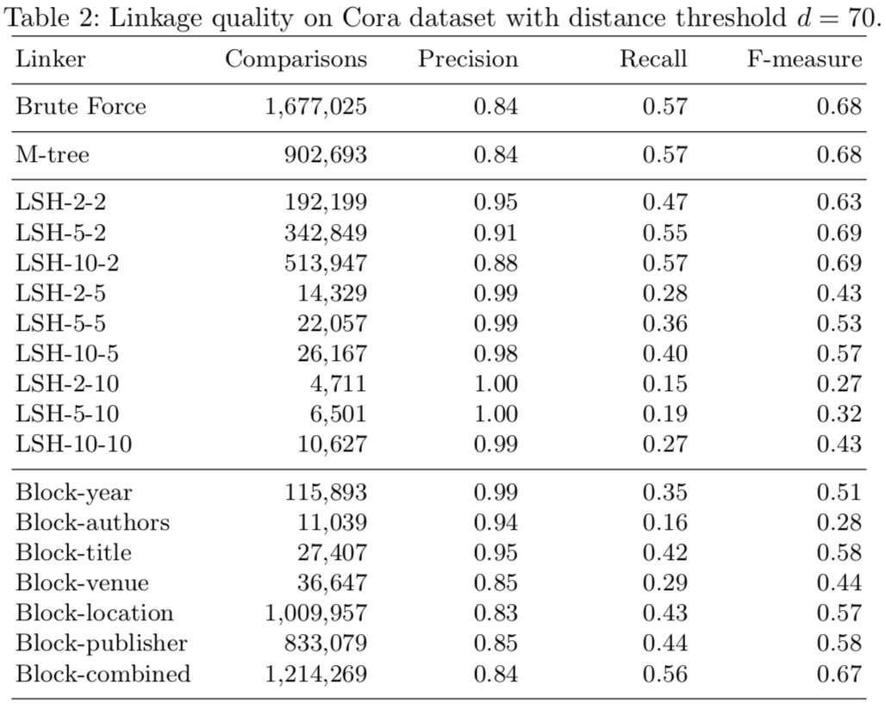

Slide 41
Isle of Skye & Kilmarnock
LSH is parameterised by number of bands and band size
We try: 2,5,10
M-Tree is not parameterised
We do not compare against traditional blocking
similar results to LSH, but needs more configuration
Brute force would take too long

Slide 42
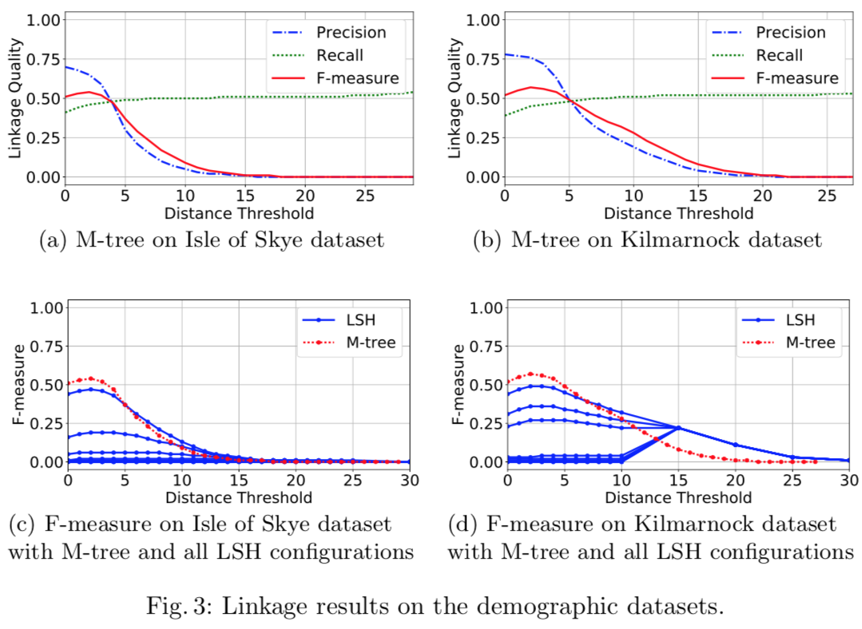

Slide 43
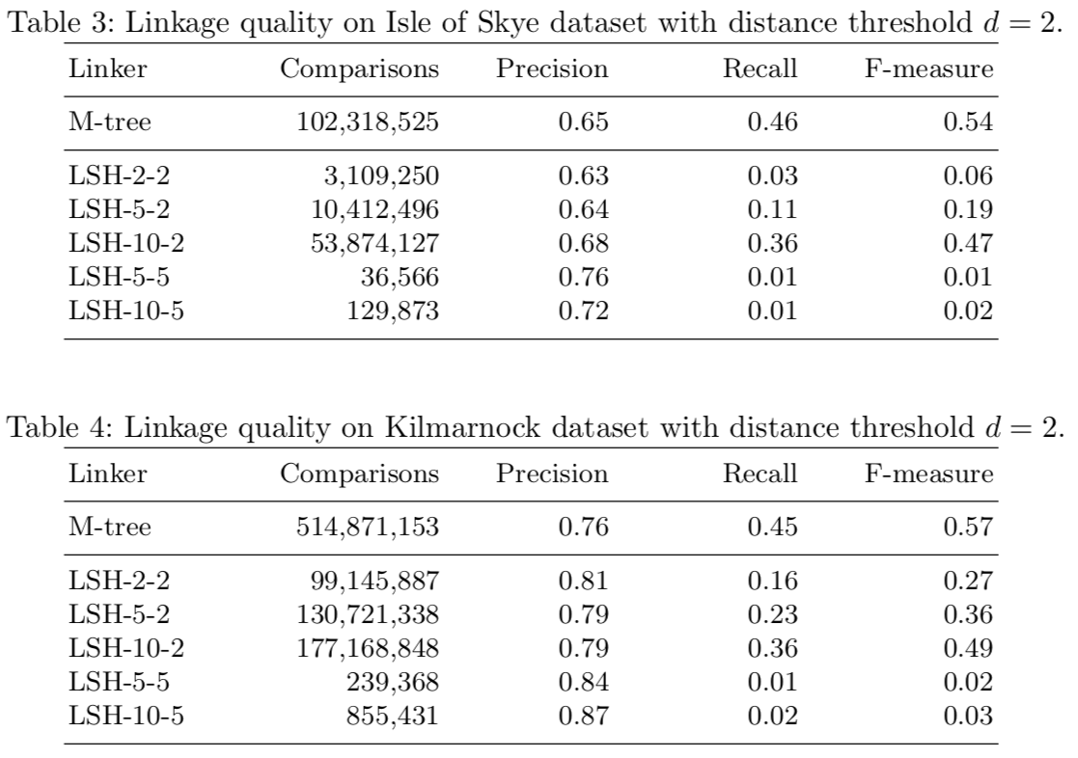

Slide 44
Summary
Metric space indexing to perform
Complete record linkage
Without resorting to brute-force
No need for complex parameter tuning

Slide 45
Future Work
We used Levenshtein + a simple sum for combining
Other distance metrics likely to give better results
Jensen-Shannon, Cosine, Structured Entropic Distance
High intrinsic dimensionality (low variation in inter-record distances) is a problem
Other metrics may have lower intrinsic dimensionality
There are methods for dimensionality reduction

Slide 46
The importance of similarity method

Slide 47
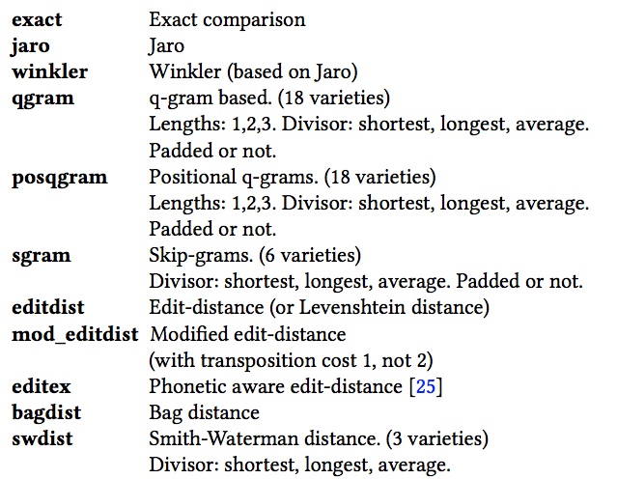
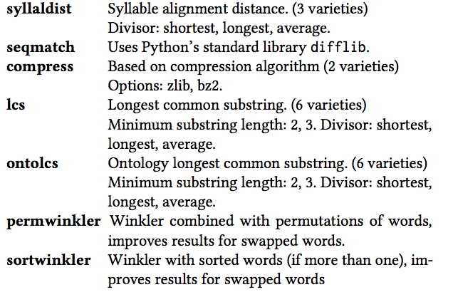
String comparison methods

Slide 48
Key fields
Pseudo-identifiers
Here, we fix to
first name, last name, gender
day, month, year of birth

Slide 49
Weights
0, 1, 2, 5, 10
Per field
Allows: Ignoring a particular field completely (Use weight 0)
Allows: Giving relatively high importance to some fields

Slide 50
Threshold
We vary the threshold from 0.60 to 1.00, with increments of 0.05
Lower threshold = easier to make links
Potentially higher recall, lower precision
Higher threshold = harder to make links
Potentially higher precision, lower recall

Slide 51
The search space
For N key fields, S string comparison methods, and W weight options, there are S^{N} ∗ W^{N} options.
For N = 6, S = 72, and W = 5
2.18 × 10¹⁵ configuration options
first name: <winkler, 1>; last name: <qgram, 2>; gender: <exact, 1>; ...

Slide 52
Sampling for linkage quality metrics
Comparing all pairs is impractical
Takes a very long time
Blocking is the standard method
Here, we do not need to perform linkage, only evaluate a given linkage method
Sampling a subset of the pairs

Slide 53
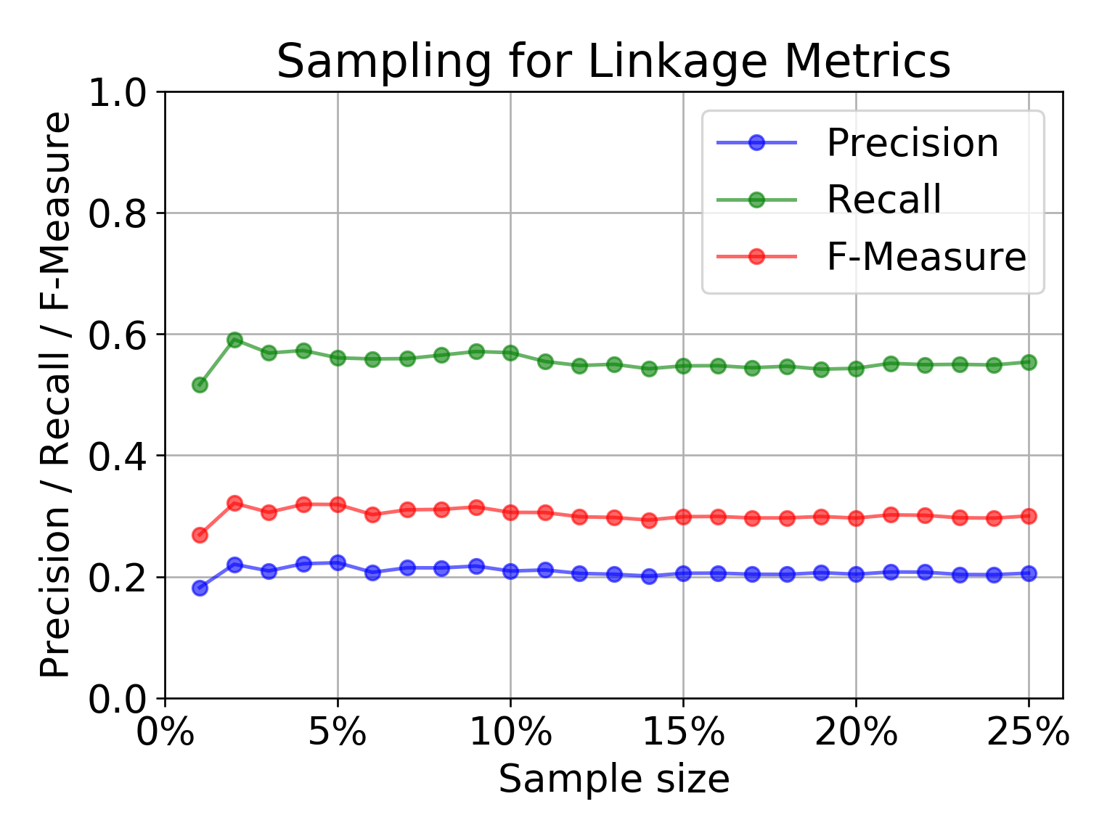
Sampling for linkage quality metrics

Slide 54
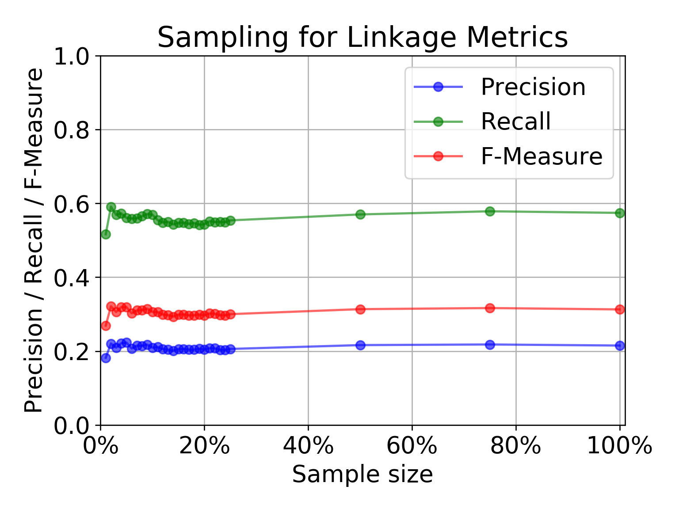
Sampling for linkage quality metrics

Slide 55
Computational experiments
12,000+ configurations in total
Shortest runtime was 5 minutes
Longest runtime was 16 hours
Average runtime was just above 1 hour
Roughly 1.75 years of computation

Slide 56
Computational experiments
We designed some configurations by hand
“Expert configurations”
The “most sensible” options
“winkler” as the string similarity method
Equal weights (+ some 0 weight, some 1)
“exact” string comparison for numeric fields

Slide 57
Computational experiments
Randomly selected some more
After evaluating the random and designed configurations, we perform local search
Change one option at a time to look for local improvements
<winkler, 1>, <exact, 2>, <qgram,0>

Slide 58
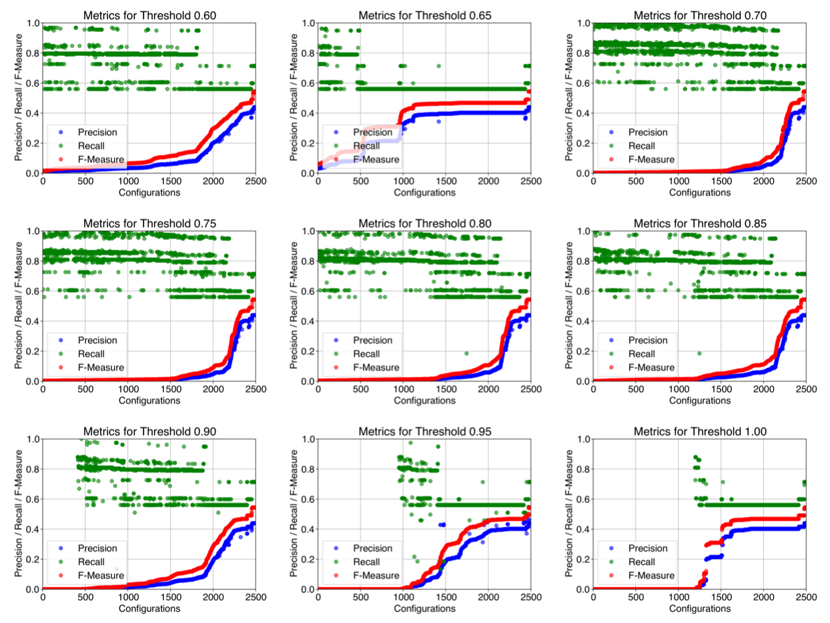

Slide 59
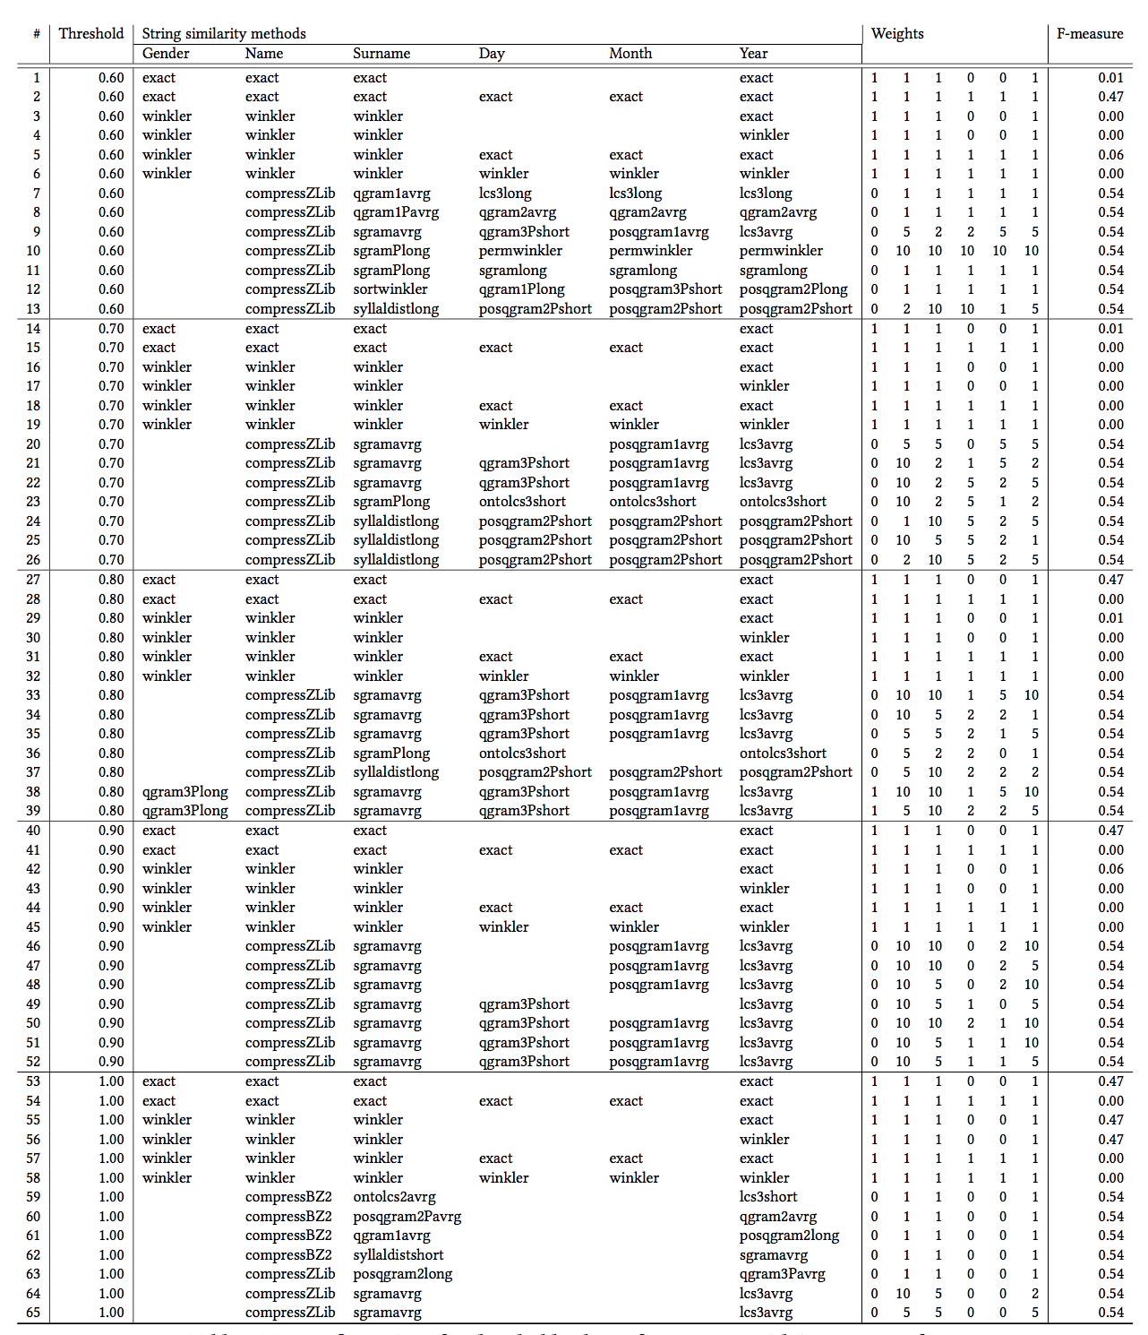

Slide 60
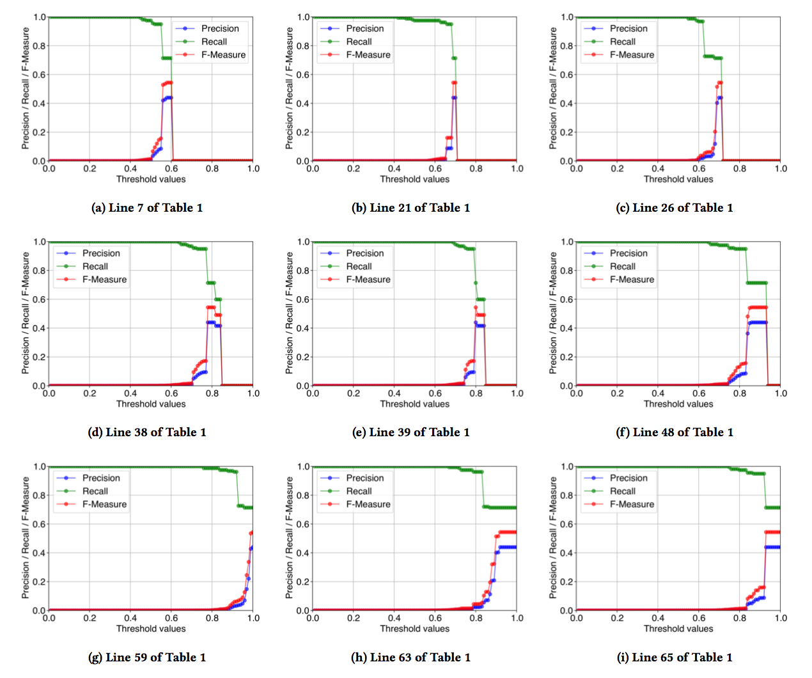

Slide 61
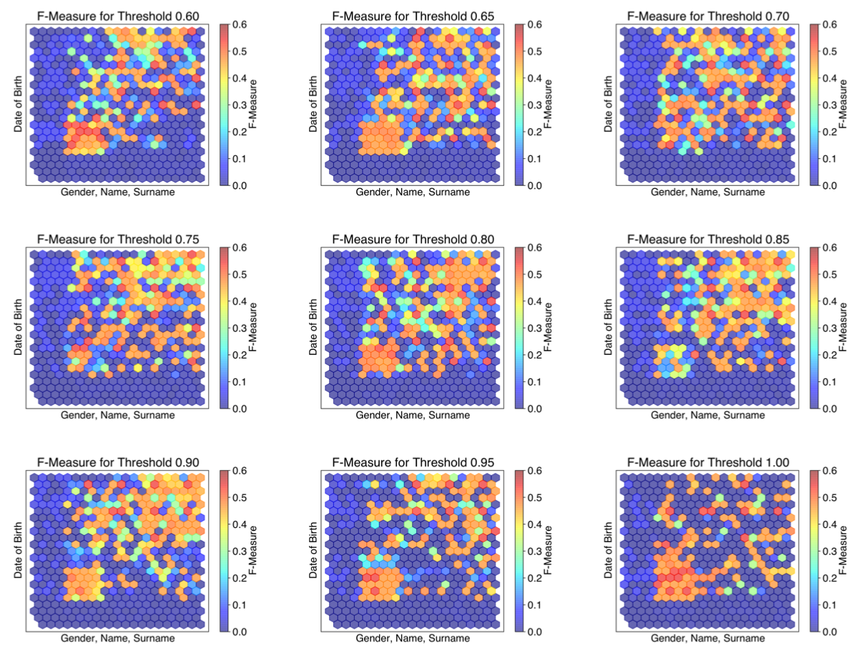

Slide 62
Computational experiments
Designed configurations give a maximum F-measure value of 0.47
0.47 is not bad, considering how easy it is to achieve in terms of design
Via search, we achieve configurations with F-measure value of 0.54
Small improvement, but can be very valuable

Slide 63
Computational experiments
Discarding gender information, better linkage quality
Compression based string comparison methods effective for first names
Syllable alignment distance based methods seem to perform well for surnames
Best configurations omit the day and the month of date of birth; less reliable?

Slide 64
Conclusion
A good similarity method is crucial for achieving good quality linkage.
Configured randomly, extremely poor linkage quality.
Can do better than obvious choices
Still, poor quality with standard algorithms
More sophisticated methods can achieve much better linkage quality (we have some unpublished on this!)
Making use of more information
For example the family structure

Slide 65
Presenting at PAKDD 2018 next week
Available: https://github.com/digitisingscotland/pakdd2018-metric-linkage

